Slide 1
Soft Jellyfish Propulsion Simulation Final Update
By: Robert Marlow and Mark Lee

Slide 2
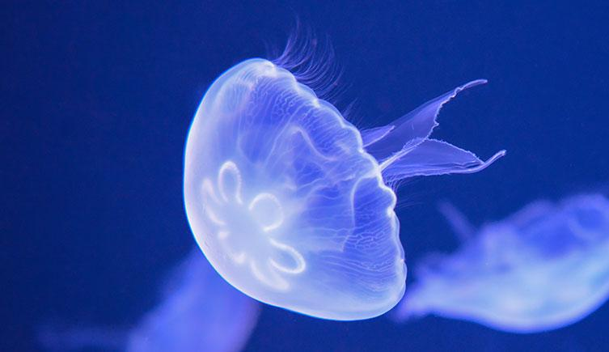
Motivation
The Initial motivation to simulate a soft jellyfish was to understand how flexible structures interact with hydrodynamic forces to produce propulsion.
Understanding this propulsion would allow us to optimize the soft jelly’s parameters to create the most efficient design for our simulation

Slide 3
Overview / Approach
The goal of the project is to model a soft jellyfish robot that propels itself through water by contracting its bell
Marine robots are increasingly valuable to scientific study and commercial exploration^{[1]}
Jellyfish are a promising option for locomotion biomimicry because they consume very little energy^{[2]}
Simulate a simple 2D cross section of a jellyfish using rods to connect 5 nodes together

Slide 4
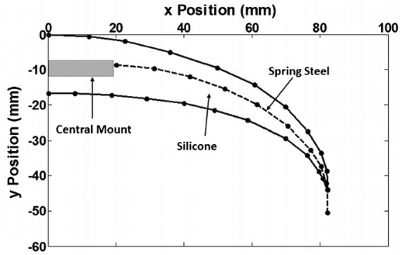
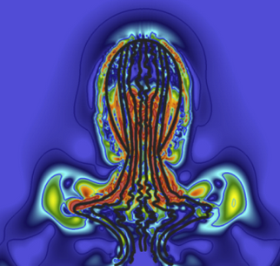
Past Work
Existing simulations of elastic deformation in actuated soft jelly robots
Discrete differential geometry seems well-suited to this task
Computationally-heavy methods usually used to model fluid-structure interactions
Would be cool if we could do it faster
BISMAC Actuated Bell Cross-Section^{[2]}
Detailed fluid simulation in IB2D^{[4]}

Slide 5
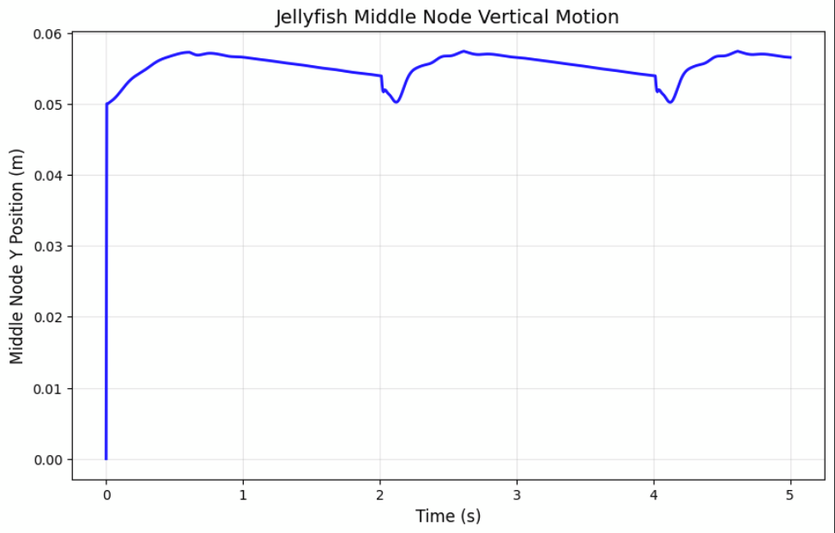

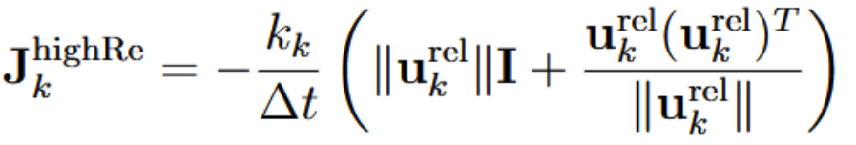
Previous Challenges
No net movement under low-Re drag
Reciprocal motion cannot produce thrust when Re << 1, per the Scallop Theorem^{[7]}
Actual jellyfish swim at Re = 150 ~ 500^{[4], [5]}
Implemented high-Re (quadratic) drag^{[6]}
Initially still no propulsion
Started to see change by increasing C_{D} (0.42 -> ~100)

Slide 6
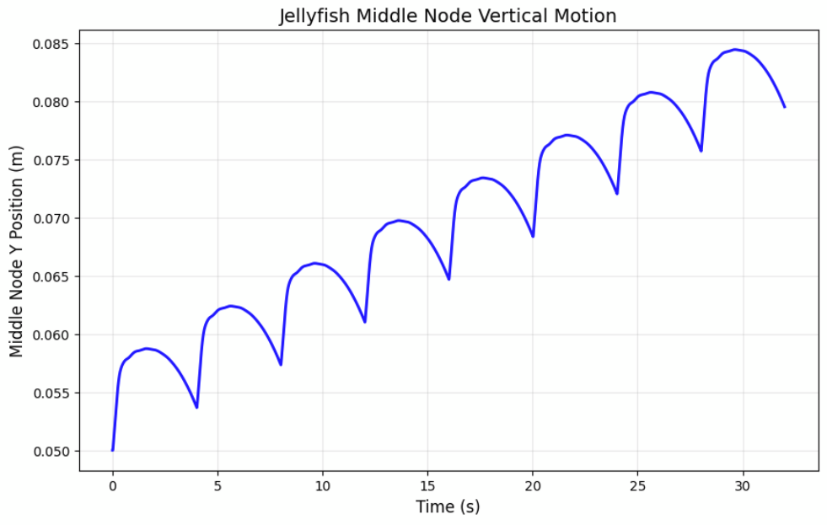
Progress in Results
Simulation now predicts net forward movement
Model simplifications resulted in lower thrust force than nature
Including farther-field effects like jetting and vortexing would slow computation
2.5x speed
Height = 0.08 m
Width = 0.1 m
Thickness = 0.04 m
Timestep = 0.01 s
N_{nodes} = 5
Bending Stiffness EI = 0.01 N-m/rad
Stretching Stiffness EA = 30 N/m
Bell Density = 1050 kg/m³
Seawater Density = 1025 kg/m³
Drag Coefficient C_{D} = 100

Slide 7
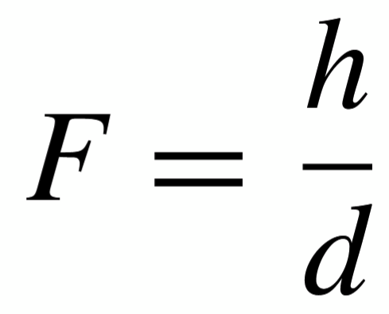
Bell Fineness Ratio
Species are generally categorized as prolate (F > 1.0) or oblate (F < 0.5)^{[1]}
Prolate propulsion dominated by jetting
Oblate propulsion dominated by vortices
Oblate species are more efficient
F = 0.4
F = 0.6
F = 0.8
F = 1

Slide 8
Effects of Contraction Amplitude
At higher amplitudes, arm drag force works against forward movement
Pulling the arms in this far also costs more wasted energy
Modeled differing levels of contraction uniformity
In nature, oblate species deform more along the edges and prolate species deform more near the apex^{[1]}
Larger Amplitude
Smaller Amplitude

Slide 9
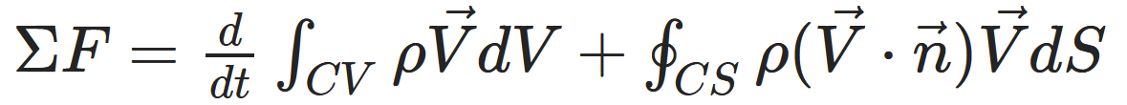
Modeling More Phenomena
Simplified assumptions to include jetting thrust
Conservation of momentum:
Jet velocity calculated from change in area under bell
Distributed force applied to all nodes
Some Jetting
No Jetting

Slide 10
Future Progress
Implement a more robust hydrodynamic model that could include
Modeling the mass of the water inside of the jellyfish’s bell to more accurately simulate the hydrodynamics
Implement some sort of natural jetting force or some sort of vorticity generation
Increase the number of nodes our model can accurately simulate to create a more wave like motion
Bring this simulation to 3D which would allow for more complicated plate simulations
Non Uniform stiffness/geometry

Slide 11
References
J. Najem, S. A. Sarles, B. Akle, and D. J. Leo, “Biomimetic jellyfish-inspired underwater vehicle actuated by ionic polymer metal composite actuators,” Smart Mater. Struct., vol. 21, no. 9, p. 094026, Sep. 2012, doi: 10.1088/0964-1726/21/9/094026.
A. Villanueva, C. Smith, and S. Priya, “A biomimetic robotic jellyfish (Robojelly) actuated by shape memory alloy composite actuators,” Bioinspir. Biomim., vol. 6, no. 3, p. 036004, Sep. 2011, doi: 10.1088/1748-3182/6/3/036004.
L. Xiangbin and Y. Junzhi, “Design and simulation of a robotic jellyfish based on mechanical structure drive and adjustment,” in 2015 34th Chinese Control Conference (CCC), Jul. 2015, pp. 5953–5958. doi: 10.1109/ChiCC.2015.7260571.
J. G. Miles and N. A. Battista, “Naut Your Everyday Jellyfish Model: Exploring How Tentacles and Oral Arms Impact Locomotion,” Fluids, vol. 4, no. 3, p. 169, Sep. 2019, doi: 10.3390/fluids4030169.
S. R. Anuszczyk and J. O. Dabiri, “Electromechanical enhancement of live jellyfish for ocean exploration,” Bioinspir. Biomim., vol. 19, no. 2, p. 026018, Mar. 2024, doi: 10.1088/1748-3190/ad277f.
M. K. Jawed and S. Lim, “Discrete Simulation of Slender Structures.” Accessed: Oct. 10, 2025. [Online].
E. M. Purcell, “Life at low Reynolds number,” Am. J. Phys., vol. 45, no. 1, pp. 3–11, Jan. 1977, doi: 10.1119/1.10903.

